Slide 1

Structures and Unions in C
Dr. Murali Krishna Enduri
Department of CSE

Slide 2
C: Structures Introduction
C: Structures Introduction
Structures
Collections of related variables (aggregates) under one name
Can contain variables of different data types
Commonly used to define records to be stored in files
A struct is heterogeneous in that it can be composed of data of different types
In contrast, array is homogeneous since it can contain only data of the same type
Combined with pointers, can create linked lists, stacks, queues, and trees
Example:
The “Date” structure
has 3 members,
day, month & year.
The “StudentInfo” structure has 4 members
of different types:
Id, Age, Gender,CGA
The “BankAcount” structure has simple, array and structure
types as members.

Slide 3
C: structure definition
Definition of a structure:
struct <struct-type>{
<type> <identifier_list>;
<type> <identifier_list>;
...
} ;
Example:
struct Date {
int day;
int month;
int year;
} ;
Each identifier defines a member of the structure.
The “Date” structure
has 3 members,
day, month & year.

Slide 4
C: struct example
Example:
struct StudentInfo{
int Id;
int age;
char Gender;
double CGA;
};
Example:
struct StudentGrade{
char Name[15];
char Course[9];
int Lab[5];
int Homework[3];
int Exam[2];
};
The “StudentInfo” structure has 4 members
of different types.
The “StudentGrade” structure has 5 members of
different array types.

Slide 5
C: struct basics
Declaration of a variable of struct type:
<struct-type> <identifier_list>;
Example:
StudentRecord Student1, Student2;
Student1 and Student2 are variables of StudentRecord type.
struct StudentRecord{
char Name[20];
int Id[20];
char Gender;
int Dept[20];
};
Name
Id Gender
Dept
Name
Id Gender
Dept
Student1
Student2

Slide 6
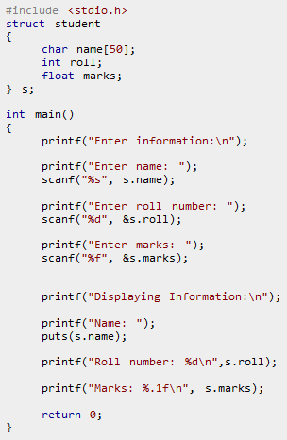
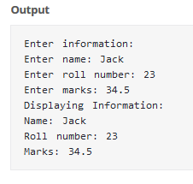

Slide 7

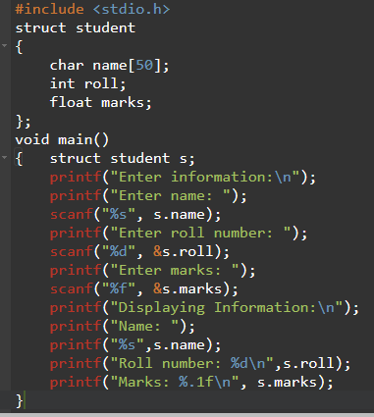

Slide 8
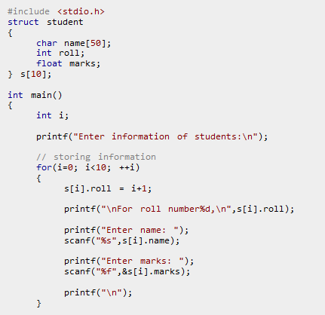
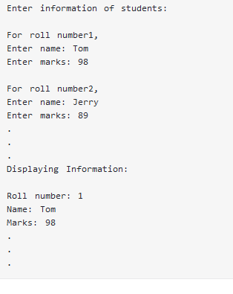
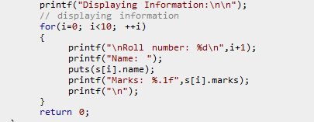

Slide 9
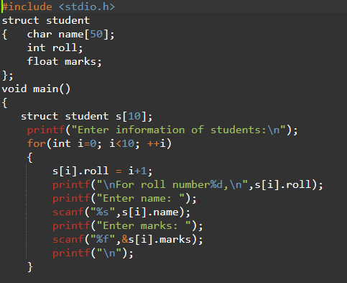
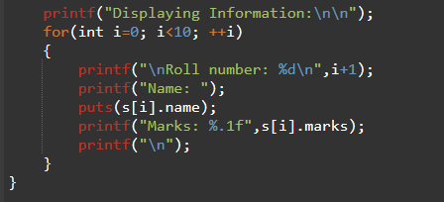

Slide 10
C: struct-to-struct assignment
The values contained in one struct type variable can be assigned to another variable of the same struct type.
Example:
strcpy(Student1.Name, “Raju"); Student1.Id = 12345; strcpy(Student1.Dept, “CSE"); Student1.gender = 'M'; Student2 = Student1;
Raju
12345 M
CSE
Student1
Raju
12345 M
CSE
Student2

Slide 11
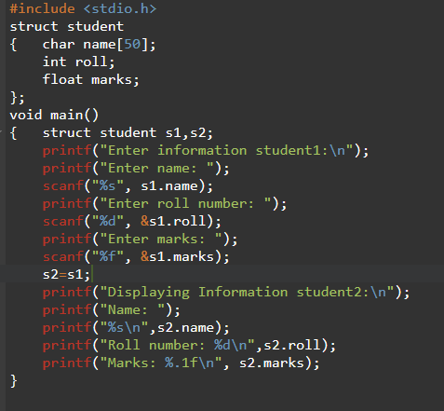
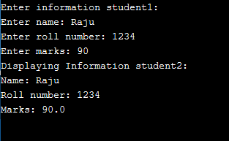

Slide 12
C: Nested structures
The “Date” structure
has 3 members,
day, month & year.
struct Date {
int day;
int month;
int year;
};
The “BankAcount” structure has simple, array and structure
types as members.
struct BankAccount{
char Name[15];
int AcountNo;
double balance;
struct Date Birth;
};

Slide 13
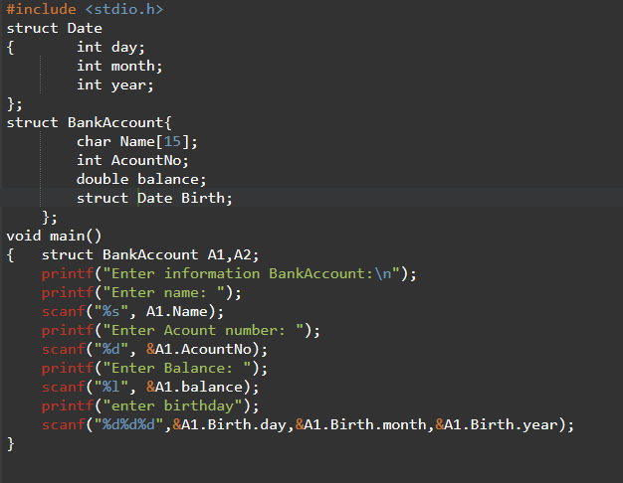

Slide 14
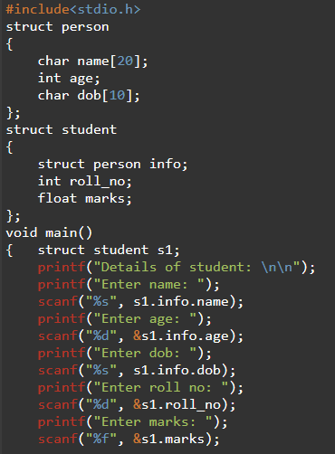
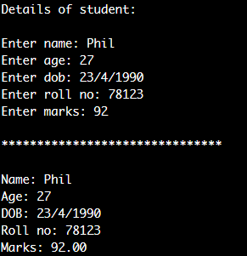
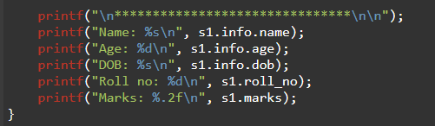

Slide 15
Examples:
struct point{ double x, y; }; struct line{ struct point p1, p2; }; struct triangle{ struct point p1, p2, p3; };
struct point P;
struct line L;
struct triangle T;
(P.x, P.y)
(L.p2.x, L.p2.y)
(L.p1.x, L.p1.y)
(T.p2.x, T.p2.y)
(T.p3.x, T.p3.y)
(T.p1.x, T.p1.y)

Slide 16
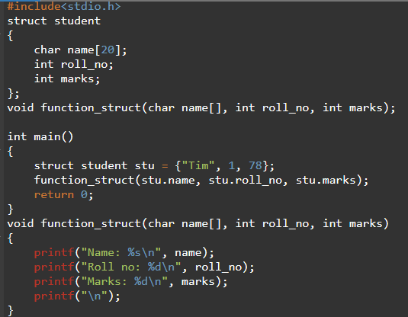
C: structures and functions
Passing Structure Members as arguments to Function
Name: Tim
Roll no: 1
Marks: 78

Slide 17
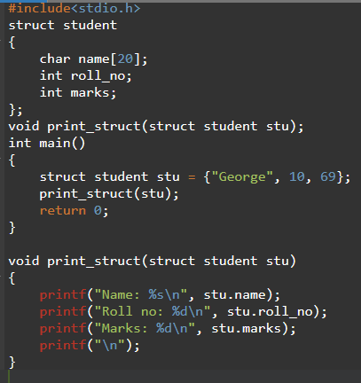
C: structures and functions
Passing Structure Variable as Argument to a Function
Name: George
Roll no: 10
Marks: 69

Slide 18
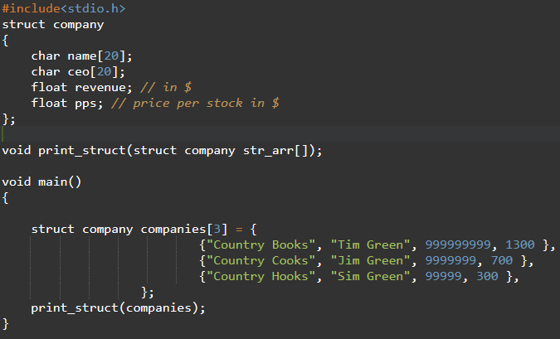
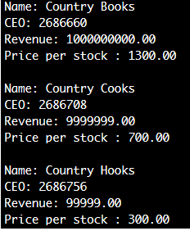
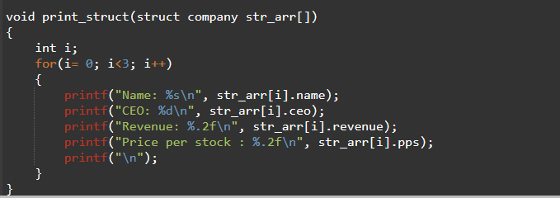
C: array of structures and functions
Array of Structures as Function Arguments

Slide 19
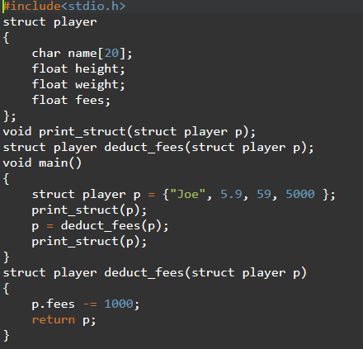
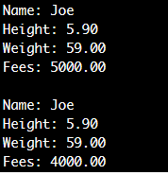
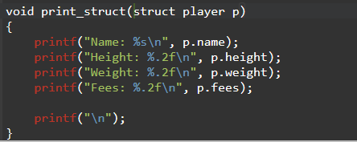
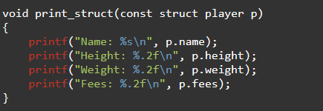
C: structures and functions with return structure
Returning Structure from Function

Slide 20
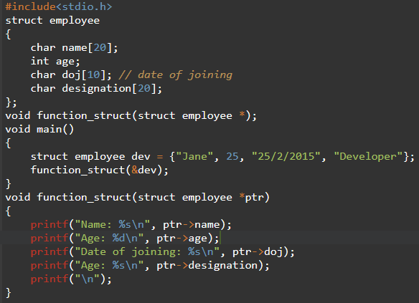
C: structures and functions using pointers
Passing Structure Pointers as Argument to a Function
For Structure Pointers we need to use
->
Name: Jin
Age: 25
Date of joining: 25/2/2015
Age: Developer

Slide 21
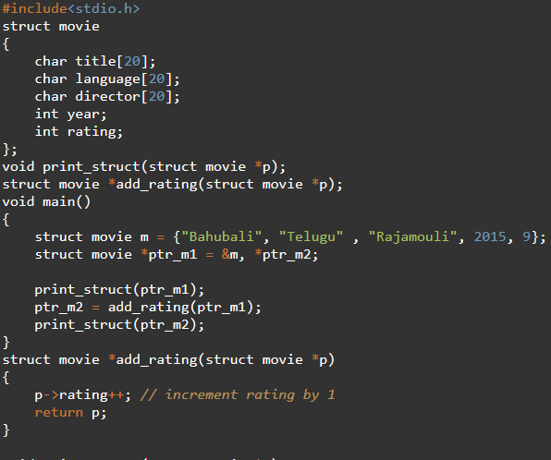
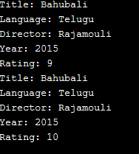
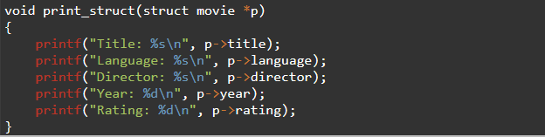
C: structures and functions with return structure pointer
Returning a Structure Pointer from Function

Slide 22
C: Practice problems on structures
Write a program to store and print the roll no., name , age and marks of a student using structures.
Write a program to store and print the roll no., name, age and marks of 5 students using structure.
Enter the marks of 5 students in Chemistry, Mathematics and Physics (each out of 100) using a structure named Marks having elements roll no., name, chem_marks, maths_marks and phy_marks and then display the percentage of each student.
Write a program to add, subtract and multiply two complex numbers using structures to function.
Calculate Difference Between Two Time Period by using structures.
Write a program to compare two dates entered by user. Make a structure named Date to store the elements day, month and year to store the dates. If the dates are equal, display "Dates are equal" otherwise display "Dates are not equal“.
Write a structure to store the roll no., name, age (between 11 to 14) and address of students (more than 5). Store the information of the students. 1 - Write a function to print the names of all the students having age 14. 2 - Write another function to print the names of all the students having even roll no. 3 - Write another function to display the details of the student whose roll no is given (i.e. roll no. entered by the user).
Write a structure to store the name, account number and balance of customers (more than 10) and store their information. 1 - Write a function to print the names of all the customers having balance less than $200. 2 - Write a function to add $100 in the balance of all the customers having more than $1000 in their balance and then print the incremented value of their balance.

Slide 23
C: Unions Introduction
union
Memory that contains a variety of objects over time
Only contains one data member at a time
Members of a union share space
Conserves storage
Only the last data member defined can be accessed
union declarations
Same as struct
union Number {
int x;
float y;
};
union Number value;

Slide 24
C: Unions Introduction
Storage
size of union is the size of its largest member
avoid unions with widely varying member sizes;
for the larger data types, consider using pointers instead
Initialization
Union may only be initialized to a value appropriate for the type of its first member
Valid union operations
Assignment to union of same type: =
Taking address: &
Accessing union members: .
Accessing members using pointers: ->

Slide 25
1 /* Fig. 10.5: fig10_05.c
2 An example of a union */
3 #include <stdio.h>
4
5 union number {
6 int x;
7 double y;
8 };
9
10 int main()
11 {
12 union number value;
13
14 value.x = 100;
15 printf( “x value: %d\n y value: %f\n",value.x,value.y);
16 value.y = 100.0;
17 printf( " x value: %d\n y value: %f\n ",value.x,value.y);
x value: 100
y value: -9255959.00000
x value: 0
y value: 100.000000
18 return 0;
19 }
Only one union member can be accessed at a time

Slide 26
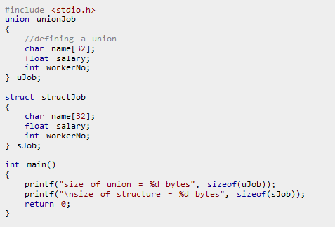
size of union = 32
size of structure = 40

Slide 27
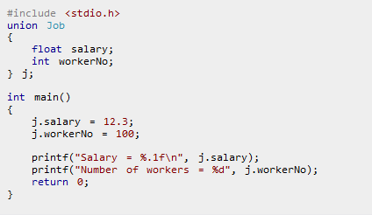
Only one union member can be accessed at a time
Salary = 0.0
Number of workers = 100

